Slide 1
HEART DISEASE PREDICTION
TSP- AI ML Fundamentals (Capstone Project)
Presented By:
REETEHA – au810021214025
Guided By: Ramar Bose Sr. AI Master Trainer

Slide 2
OUTLINE
Problem Statement
Proposed System/Solution
Algorithm & Deployment
GitHub Link
Project Demo(photos / videos)
Conclusion
Future Scope
References

Slide 3
Problem Statement
The objective of this research is to assess the overall risk of heart disease through the application of Logistic Regression and Machine Learning techniques. As highlighted by the World Health Organization (WHO), approximately four out of five cardiovascular disease (CVD) deaths are attributed to heart attacks. The identification of individuals at risk of CVD is paramount for implementing preventive measures and providing timely interventions.

Slide 4
Proposed Solution
The proposed approach involves utilizing Logistic Regression in Google Colab for Heart Disease Prediction, comprising data processing, feature selection, and model construction stages. By leveraging the Logistic Regression model, it becomes feasible to evaluate an individual's susceptibility to developing cardiovascular disease. This model serves as a valuable tool for healthcare professionals in identifying high-risk patients and tailoring specific therapies and lifestyle adjustments to mitigate the risk of CVD-related outcomes.

Slide 5
Algorithm & Deployment
Data Preprocessing: The dataset undergoes preprocessing procedures to address missing values, encode categorical variables, and scale numerical features, ensuring data integrity and uniformity.
Feature Selection: Key features are chosen based on their importance in predicting CVD risk, employing methods like correlation analysis and feature importance ranking to identify the most relevant variables.
Model Development: A Logistic Regression model is constructed using the preprocessed dataset, enabling the classification of individuals into two categories: those with a risk of CVD development and those without. Through training, the model learns to effectively differentiate between these classes, facilitating accurate risk assessment.

Slide 6
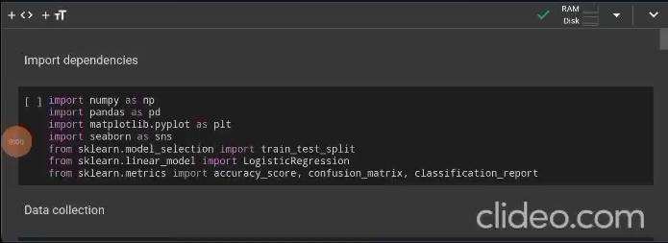
Project Demo(Recorded Video)

Slide 7
GitHub Link
Upload files · ReetehaEraiarul/Heart-disease-prediction_810021214025 (github.com)

Slide 8
Conclusion
Utilizing Logistic Regression for predicting heart disease risk offers valuable insights into identifying individuals at higher risk of developing cardiovascular disease (CVD), potentially averting adverse health consequences. This approach effectively models the probability of CVD occurrence based on various risk factors, enabling early intervention and targeted healthcare strategies. These findings underscore the significance of proactive healthcare measures, including lifestyle modifications, routine screenings, and personalized therapies, in mitigating CVD risk factors and enhancing patient outcomes.

Slide 9
Future Scope
The future outlook for heart disease prediction using Logistic Regression is promising. By incorporating additional risk factors and leveraging advanced machine learning techniques, such as ensemble methods or deep learning, future prediction models are expected to achieve higher accuracy and reliability in identifying individuals at risk of cardiovascular disease (CVD). Moreover, the concept of personalized medicine is poised to revolutionize heart disease management, as predictive models become more tailored to individual characteristics and needs, leading to more effective and targeted interventions.

Slide 10
References
Project Github link, Ramar Bose , 2024
Project video recorded link (youtube/github), Ramar Bose , 2024
Project PPT & Report github link, Ramar Bose , 2024

Slide 11
THANK YOU

